Slide 1




NEXT GEN EMPLOYABILITY PROGRAM
Creating a future-ready workforce
Team Members
College Name
Student Name : K.Kalavathy
Student ID : 513521104019
Annai Mira College Of Engineering And Technology

Slide 2

CAPSTONE PROJECT SHOWCASE
Project Title
Building Bus Reservation System using Python and Django
Abstract | Problem Statement | Project Overview | Proposed Solution | Technology Used | Modelling & Results | Conclusion

Slide 3
Abstract Online Bus Reservation System is a web based application that works within a centralized network. This project presents a review on the software program “Online Bus Reservation System” as should be used in a bus transportation system, a facility which is used to reserve seats,cancellation of reservation and different types of route enquiries used on securing quick reservations. It is built for managing and computerizing the traditional database ,ticket booking and tracking bus and travel made. It maintains all customer details ,bus details, reservation details.
Source :https://www.researchgate.net/profile/Chukwuemeka-Etus/publication/326468848_Online_Bus_Ticket_Reservation_System/links/65c97240790074549771ea6f/Online-Bus-Ticket-Reservation-System.pdf

Slide 4
Problem Statement Currently, the type of system being used at the counter is an internal system which is manually used in selling the bus tickets. The problems facing the company are that customers have to go to the counter to buy bus ticket or ask for bus schedule, customers will also have to queue up for a long time in order to secure a bus ticket and will also need to pay cash when they buy the bus ticket.
Source :https://www.researchgate.net/profile/Chukwuemeka-Etus/publication/326468848_Online_Bus_Ticket_Reservation_System/links/65c97240790074549771ea6f/Online-Bus-Ticket-Reservation-System.pdf

Slide 5
Project Overview i) Providing a web-based bus ticket reservation function where a customer can buy bus ticket through the online system without a need to queue up at the counter to purchase a bus ticket. ii) Enabling customers to check the availability and types of busses online. Customer can check the time departure for every ITC bus through the system. iii) Easing bus ticket payment by obtaining a bank pin after payments is made to the various designated banks. iv) Ability of customers to cancel their reservation. v) Admin user privileges in updating and canceling payment, route and vehicle records.

Slide 6
Proposed Solution An online bus reservation system would typically include features such as user registration, search and booking functionality, find the buses, seat selection, and booking confirmation. It would also need an admin panel for managing buses, routes, schedules, and user accounts. The system should be user-friendly, secure, and scalable to handle high traffic during peak times. Additionally, integrating features like real-time updates, feedback mechanisms, and loyalty programs could enhance the user experience. The system is developed using technologies like web development frameworks, payment gateways, and databases to ensure efficiency and reliability. Regular maintenance and updates would also be essential to keep the system running smoothly.
.
Source:https://www.researchgate.net/profile/Chukwuemeka-Etus/publication/326468848_Online_Bus_Ticket_Reservation_System/links/65c97240790074549771ea6f/Online-Bus-Ticket-Reservation-System.pdf

Slide 7
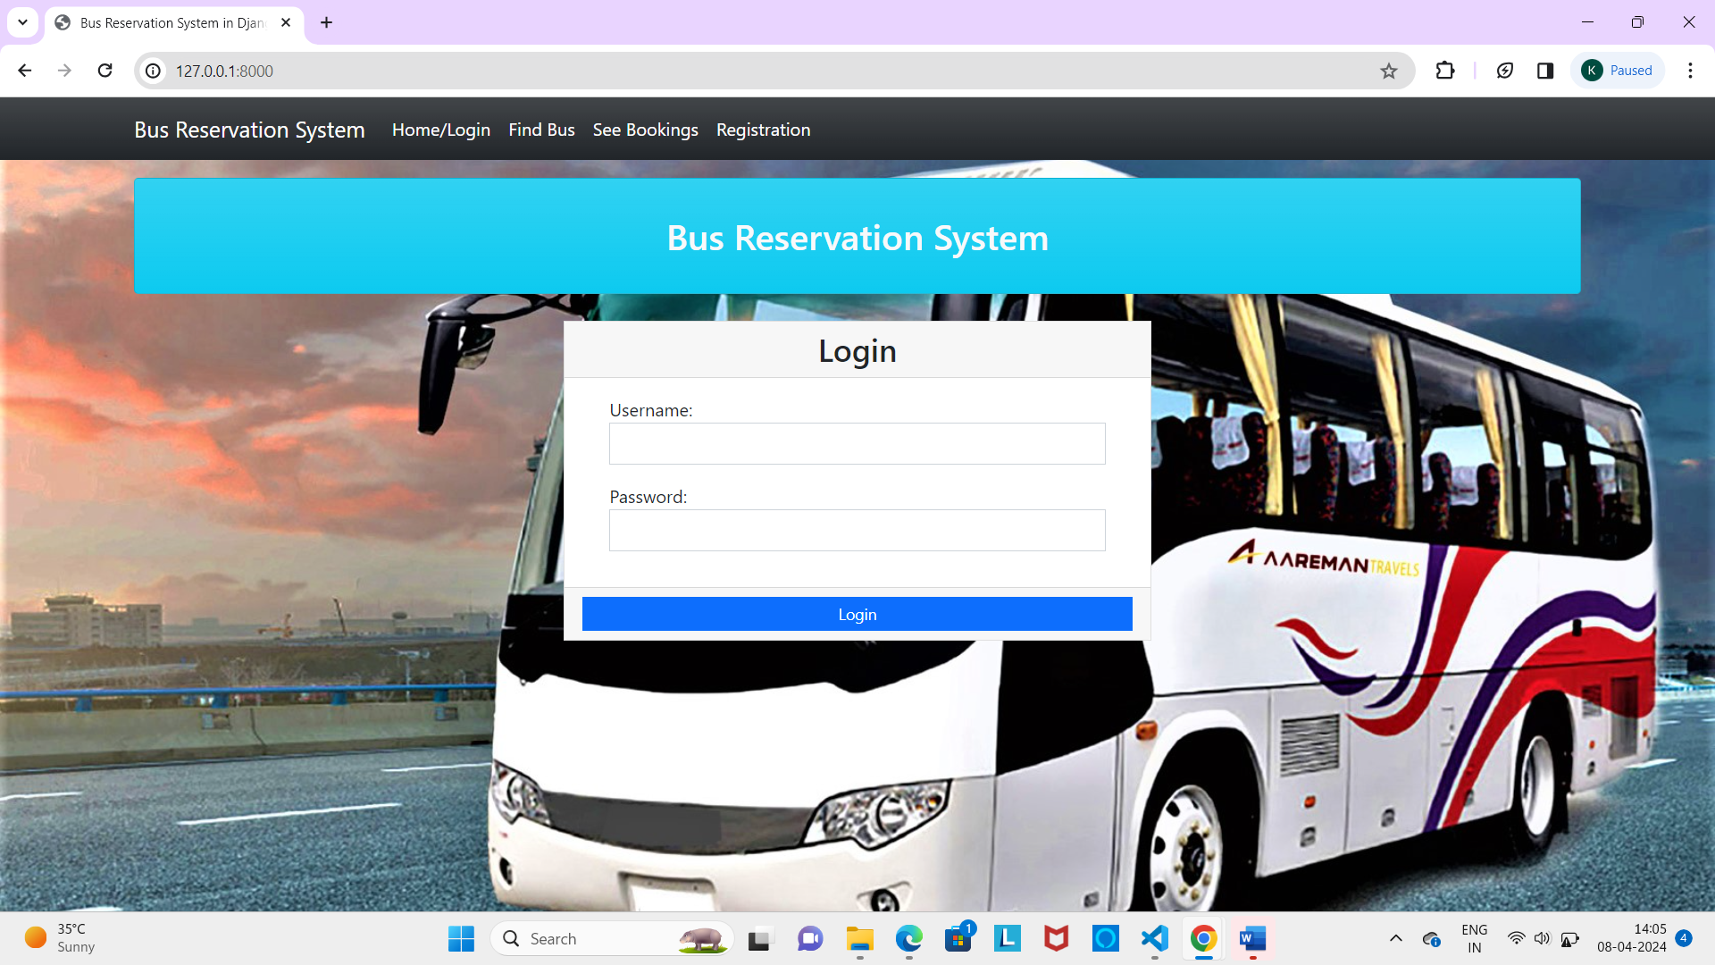
Source :

Slide 8
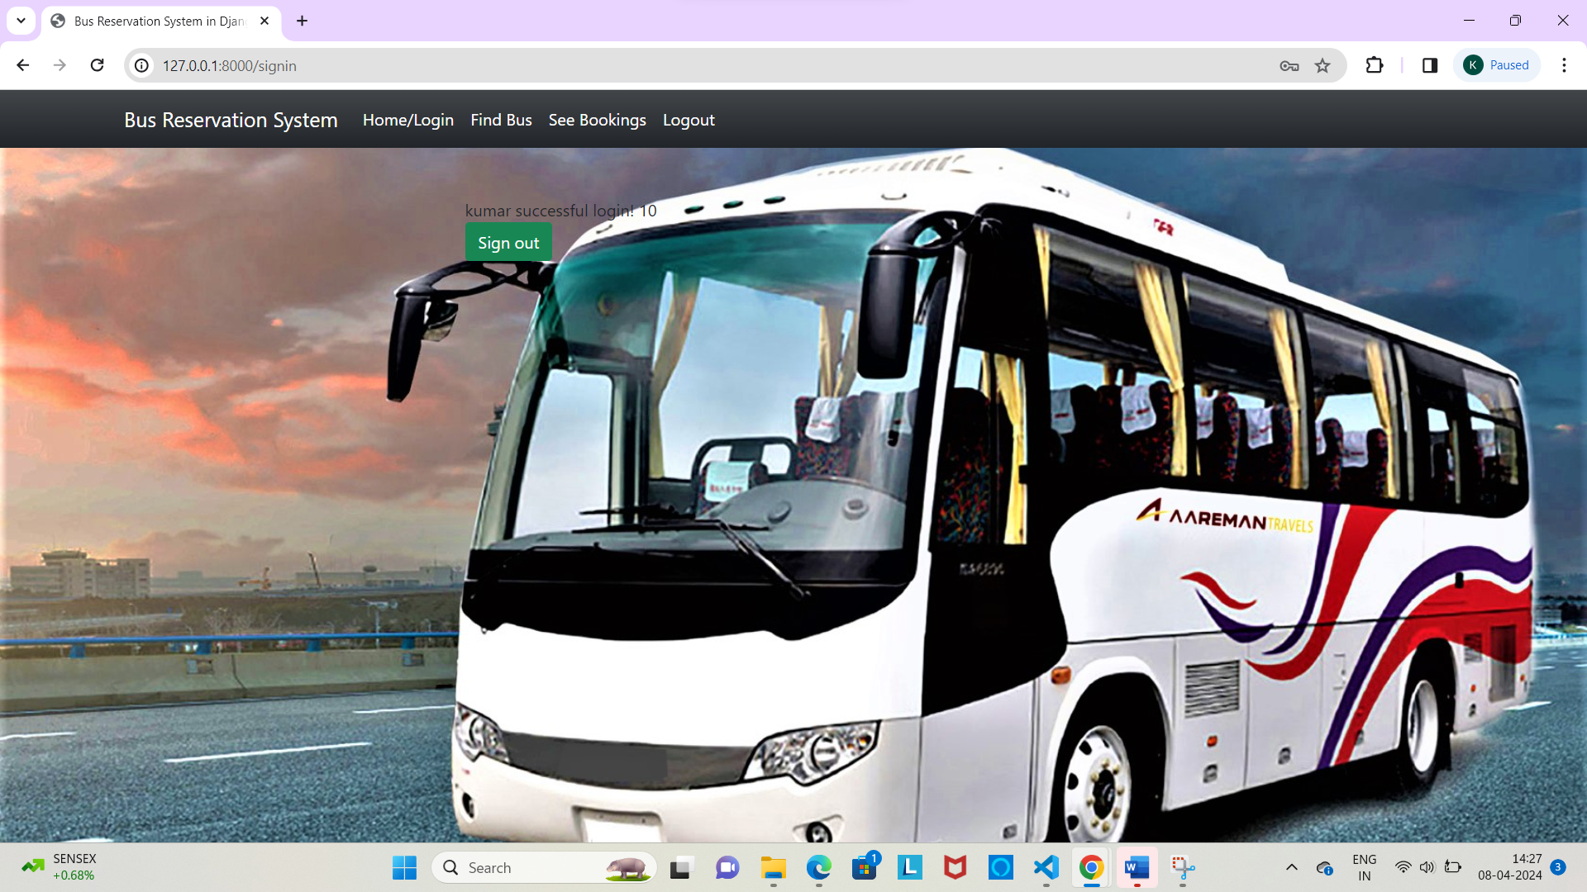
Source :

Slide 9


Technology Used
Front-end
Back-end
Source :https://www.researchgate.net/profile/Chukwuemeka-Etus/publication/326468848_Online_Bus_Ticket_Reservation_System/links/65c97240790074549771ea6f/Online-Bus-Ticket-Reservation-System.pdf

Slide 10
Modelling & Results It can be observed that computer applications are very important in every field of human endeavor. Here all the information about customer that made reservation can be gotten just by clicking a button with this new system, some of the difficulties encountered with the manual system are overcome. It will also reduce the workload of the staff, reduce the time used for making reservation at the bus terminal and also increase efficiency. The application also has the ability to update records in various files automatically thereby relieving the company’s staff the stress of working from file security of data. This project, as a whole ,will give a new way in bus reservations and ticket processes.The automation and management of seats and reservation will done online. However, this project does not limit the walk-in passengers that is passengers who visit the company’s counter because it also caters for them.
Source:https://www.researchgate.net/profile/Chukwuemeka-Etus/publication/326468848_Online_Bus_Ticket_Reservation_System/links/65c97240790074549771ea6f/Online-Bus-Ticket-Reservation-System.pdf

Slide 11
Homepage

Slide 12
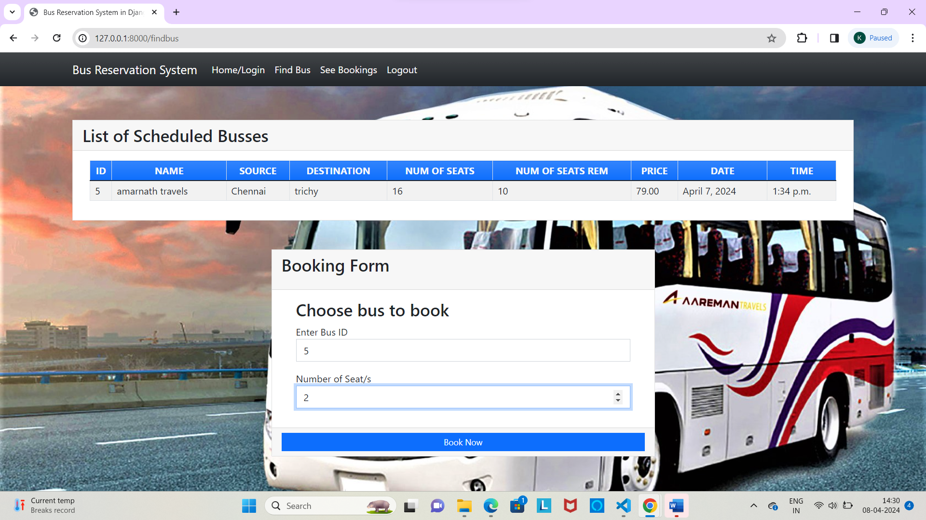
About-Us-Page

Slide 13
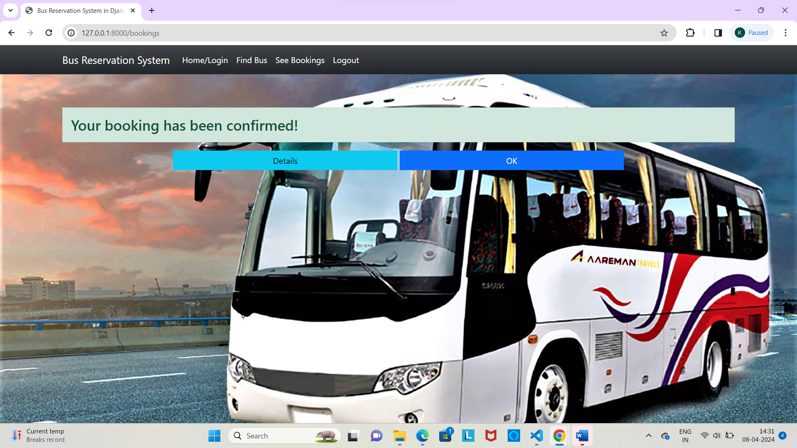
Service-Page

Slide 14
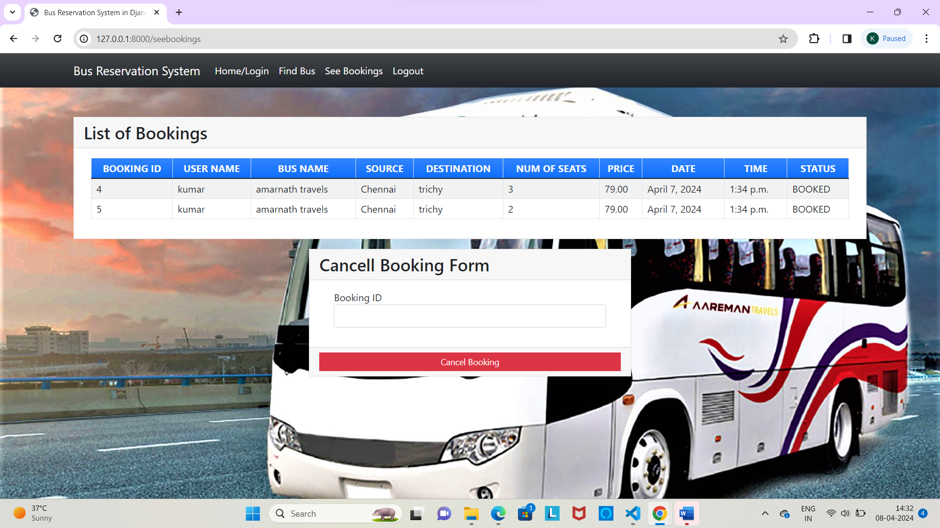
Departments-Page

Slide 15
Blog-Page

Slide 16
Future Enhancements: Dynamic Pricing: Implement dynamic pricing algorithms based on factors such as demand, time remaining until departure, and historical booking data to optimize revenue and fill empty seats. Integration with Public Transit: Integrate with public transit systems to provide seamless connections and multi-modal journey planning, allowing users to book and pay for bus tickets alongside other modes of transportation. Real-Time Tracking: Enable real-time tracking of buses and estimated arrival times for improved planning and convenience for passengers. Biometric Authentication: Integrate biometric authentication methods such as fingerprint or facial recognition for secure and convenient login and payment verification. Blockchain Integration: Explore the use of blockchain technology for secure and transparent transactions ,ticketing and tracking of bus journeys,enhancing trust and reducing fraud. Payment through netbanking: can able to pay through any kind of netbanking.

Slide 17
Conclusion: In conclusion, a bus reservation system plays a vital role in modernizing and streamlining the process of booking bus tickets for passengers. Through efficient user interfaces, robust database management, and seamless integration of various functionalities, such systems offer convenience, reliability, and accessibility to users.The future of bus reservation systems lies in continuous innovation and enhancement, driven by emerging technologies and evolving user expectations. By focusing on mobile app development, dynamic pricing strategies, predictive analytics, real-time tracking, personalized recommendations, accessibility features, virtual reality tours, biometric authentication, and blockchain integration, bus reservation systems can further elevate the user experience and meet the diverse needs of passengers.
Source :https://www.researchgate.net/profile/Chukwuemeka-Etus/publication/326468848_Online_Bus_Ticket_Reservation_System/links/65c97240790074549771ea6f/Online-Bus-Ticket-Reservation-System.pdf

Slide 18
Thank You!
Notes:
Thank You !!

